Slide 1

AI-Powered Adaptive Encryption System
for Intelligent Data Protection
CSA 5105
Cryptography & Network Security Project
Presented by
Guided by
Dr. L. P. Supriya
Mahima Prabhakaran • 192521280
Usha Nandhini P • 192511263
Yerabapu Deepthi • 192371040
N Nikhitha • 192311386

Slide 2
Abstract
02
Why the system is needed and what it delivers
Problem
Proposed System
• Traditional systems often apply a fixed encryption method to every file.
• A fixed strategy may not balance security requirements and computational cost.
• Users may not know which cryptographic strategy is appropriate for a given file.
• AEGIS analyzes file type, file size, sensitivity and user priority.
• A Decision Tree recommends an appropriate encryption strategy.
• The selected cryptographic algorithm performs the real encryption.
• The application exposes the lifecycle: key generation, encryption, integrity, ciphertext inspection, saving and authorized decryption.
• Audit logs and performance metrics provide accountability and transparency.

Slide 3
Introduction
03
With the increasing volume of digital data, protecting sensitive files from unauthorized access and modification has become essential.
Traditional systems often rely on a fixed encryption algorithm for different types of files, without considering their individual security and performance requirements.
Our project, AI-Powered Adaptive Encryption System, combines Machine Learning with established cryptographic techniques to provide intelligent and adaptive file protection.
The system analyzes file type, file size, sensitivity, and user priority and uses a Decision Tree to recommend a suitable encryption strategy.
The selected algorithm performs the actual encryption, while SHA-256, authenticated encryption, secure key management, audit logging, and ciphertext inspection strengthen the protection and transparency of the system.
Core Idea
Analyze → Decide with AI → Encrypt → Verify → Save/Inspect → Securely Decrypt 🔐

Slide 4
Motivation
04
Moving from fixed encryption to adaptive protection
The limitation of a one-size-fits-all approach
Project Motivation
1
Same algorithm for every file
• Adapt protection to the characteristics of the uploaded file.
• Balance security and performance through explicit user priorities.
• Use established cryptographic algorithms rather than inventing a new cipher.
• Make the cryptographic process visible and explainable.
• Create an auditable platform suitable for practical demonstration.
Ignores file characteristics and security priorities.
2
Possible security / performance mismatch
A strategy optimized for one situation may not be ideal for another.
3
Need for intelligent selection
Machine Learning can assist in selecting a suitable strategy.

Slide 5
Objectives
05
01
Adaptive Selection
Use Machine Learning to recommend a suitable encryption strategy.
02
Strong Cryptography
Implement authenticated encryption and protected key management.
03
Transparent Workflow
Show the user what happens from file analysis to ciphertext and verification.
04
Secure Retrieval
Support authorized decryption and integrity verification.
05
Accountability
Maintain audit logs, access control and performance statistics.
What the project is designed to achieve

Slide 6
Literature Survey
Existing approaches and the gap addressed by AEGIS
Author & Year | Research Focus | Key Contribution | Limitation / Gap
Rath et al. (2024) | AES–RSA hybrid security | Combines AES and RSA for confidentiality, integrity and key management. | Fixed hybrid scheme; no adaptive selection.
Bharti & Singh (2024) | AES–RSA for cloud security | Uses AES for data and RSA for secure key exchange. | Does not intelligently select the approach.
Alghamdi & Munir (2024) | Image encryption survey | Reviews security and computational evaluation of encryption methods. | Compares methods rather than dynamically selecting one.
Paracha et al. (2024) | ML security & privacy | Highlights ML for cybersecurity and security automation. | Does not integrate ML with adaptive encryption.

Slide 7
System Modules
07
Secure User Registration & File Management
AI Adaptive Encryption Engine
Authentication, upload, file analysis, sensitivity and priority capture.
Decision Tree analyzes the input features and recommends a strategy.
Adaptive Encryption & Secure Storage
Audit, Performance & Access Control
Performs AES/ChaCha20/Hybrid encryption, integrity protection, saving and decryption.
Records activity, controls roles and displays security/performance analytics.
Four modules form one continuous application workflow

Slide 8
Module 1 — Secure User Registration & File Management
08
Input
Process
Output
• Username and password
• File to upload
• Sensitivity: Low / Medium / High
• Priority: Speed / Balanced / Security
• Register / authenticate user
• Verify credentials
• Receive uploaded file
• Detect file type and extension
• Calculate file size
• Prepare metadata and security profile
• Authenticated user
• Uploaded file
• File metadata
• Security profile for Module 2
• Audit event for user activity
Creates the trusted starting point and prepares inputs for the AI engine

Slide 9
Module 2 — AI Adaptive Encryption Engine
09
INPUT FEATURES
POSSIBLE RECOMMENDATIONS
1
File type / category
AES-256-GCM
Feature supplied by Module 1
DECISION TREE CLASSIFIER
Authenticated symmetric encryption
2
File size
Feature supplied by Module 1
Receives the four feature groups and predicts the most suitable encryption strategy. Output: recommendation + confidence.
ChaCha20-Poly1305
3
Sensitivity level
Feature supplied by Module 1
Authenticated stream encryption
4
User priority
Feature supplied by Module 1
Hybrid AES-256-GCM + RSA-2048 OAEP
AES encrypts data; RSA protects the AES key
Important: Decision Tree = selection layer. Cryptographic algorithms = protection layer.
The AI layer selects the cryptographic strategy; it does not encrypt the file itself

Slide 10
Module 3 — Adaptive Encryption & Secure Storage
CRYPTOGRAPHIC ALGORITHMS USED
AES-256-GCM
ChaCha20-Poly1305
RSA-2048 OAEP
SHA-256
Symmetric authenticated encryption
Authenticated stream encryption
Asymmetric key protection
Cryptographic hash
MODULE 3 WORKING
1
Key / nonce
2
Encrypt
3
Integrity
4
Store
5
Transparent actions
Generate required cryptographic material; secret keys remain hidden.
Convert plaintext into ciphertext using the selected strategy.
Use authentication + SHA-256 reference to detect alteration.
Keep ciphertext and non-secret metadata for authorized retrieval.
Save .aegis • Inspect ciphertext • Decrypt & verify
Performs the actual cryptography and exposes a transparent post-encryption workflow

Slide 11
Module 4 — Audit, Performance & Access Control
11
Audit Logging
Performance
Access Control
• Login and failed-login events
• Encryption and decryption events
• AI recommendation events
• Ciphertext inspection / save actions
• Timestamped activity records
• Encryption time
• Decryption time
• Algorithm usage statistics
• Protected-file statistics
• Performance dashboard
• Authenticated users
• User / administrator roles
• Authorized file retrieval
• Restricted administrative views
• Security-focused monitoring
Turns cryptographic activity into measurable and traceable system evidence

Slide 12
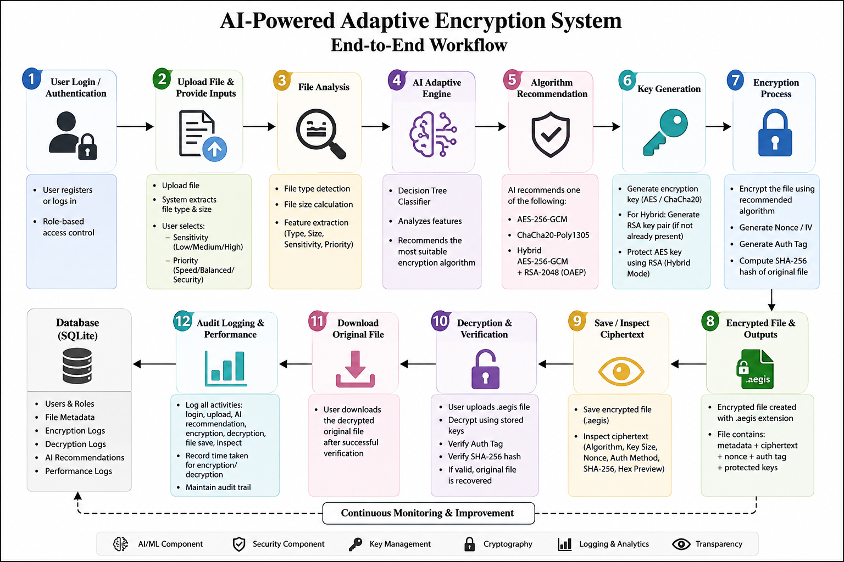
System working
12
1
↓ SAVE ENCRYPTED FILE
⌕ INSPECT CIPHERTEXT
🔓 DECRYPT & VERIFY
Downloads the actual ciphertext container as a .aegis file.
Shows algorithm, nonce, authentication, SHA-256 and a hex preview of ciphertext.
Decrypts for an authorized user and verifies integrity before returning the original.

Slide 13
Results & Discussion
13
Functional outcomes demonstrated by the current application
Secure access
Adaptive decision
Registration and login create the authenticated entry point.
Decision Tree converts file/security characteristics into an algorithm recommendation.
Real encryption
Transparent evidence
The selected AES, ChaCha20 or hybrid cryptographic strategy produces ciphertext.
Users can save the encrypted output and inspect ciphertext metadata/hex bytes.
Integrity verification
Auditability
SHA-256 plus authenticated-encryption checks support tamper detection.
Cryptographic activity and performance information are recorded for monitoring.
Discussion: the strongest contribution is the integration of adaptive selection + established cryptography + transparent verification in one demonstrable workflow.

Slide 14
Advantages Compared with a Fixed Encryption Approach
14
Aspect | Fixed / conventional approach | Proposed AEGIS approach
Algorithm choice | One predefined encryption method | ML-assisted adaptive recommendation
Adaptation | Limited or manual | Uses file characteristics + security preference
Cryptography | Encryption may be treated as a black box | Algorithm, parameters and process are visible
Integrity | May be handled separately | Authenticated encryption + SHA-256 reference
Key protection | Depends on implementation | Dedicated key generation; RSA protection in hybrid mode
User evidence | Basic success/failure | Save ciphertext + inspect ciphertext + verification
Monitoring | Limited activity visibility | Audit logs + algorithm/performance statistics
Why the proposed workflow is useful beyond simply encrypting a file

Slide 15
Conclusion
15
Key Takeaways
• AEGIS combines Machine Learning with established cryptographic algorithms rather than replacing cryptography with AI.
• The Decision Tree performs adaptive selection using file type, size, sensitivity and priority.
• AES-256-GCM, ChaCha20-Poly1305 and Hybrid AES-256-GCM + RSA-2048 OAEP provide the protection layer.
• SHA-256 and authenticated encryption support integrity verification.
• The application makes the process demonstrable through .aegis saving, ciphertext inspection, decryption, audit logging and performance monitoring.
Final message: Intelligent selection + strong cryptography + transparent evidence = practical adaptive data protection.

Slide 16
THANK YOU
AI-Powered Adaptive Encryption System
Questions & Discussion
Cryptography • Machine Learning • Secure File Protection

